Slide 1

Programming (csc7060)
Aidan McGowan
Searching
Linear
Binary

Slide 2
Introduction
Searching data involves determining whether a value (referred to as the search key) is present in the data and, if so, finding its location.
Two popular search algorithms are the simple linear search and the faster but more complex binary search.

Slide 3

Between 1 and 20….

Slide 4

Linear Search
Easy to program yet relatively inefficient
The linear search algorithm searches each element in an array sequentially.
  If the search key does not match an element in the array: the algorithm tests each element and when the end of the array is reached, informs the user that the search key is not present.
  If the search key is in the array: the algorithm tests each element until it finds one that matches the search key and returns the index of that element.

Slide 5
Linear Search
consider an array containing the following values and a program that is searching for 51
Using the linear search algorithm, the program first checks whether 34 matches the search key. It does not, so the algorithm checks whether 56 matches the search key. The program continues moving through the array sequentially, testing 2, then 10, then 77. When the program tests 51, which matches the search key, the program returns the index 5, which is the location of 51 in the array. If, after checking every array element, the program determines that the search key does not match any element in the array, it may return a default value (e.g., -1).
Efficiency : O(n)

Slide 6
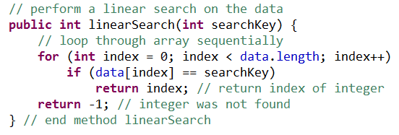
Searching code

Slide 7
Exercise – Linear search
Create an class LinearArray.java that upon instantiation generates an array of 50 random integers. (values from 10-99)
Include in the class an Arrays.ToString() method and the linearSearch() method (previous slide).
Create another class to test the LinearArray.java by searching for a specified number.
Output to the user if the value is in the array and if so output the index position.
If the value is not in the array output an appropriate message.

Slide 8
Between 1 and 1000 ….

Slide 9
Binary Search
More efficient than linear search
But it requires that the array is sorted.
The first iteration of this algorithm tests the middle element in the array. If this matches the search key, the algorithm ends.
Otherwise if the middle element is greater that search element search to the right.
If it is less then search to the left.
This is then repeated until the item is found or the item does not exist in the array

Slide 10
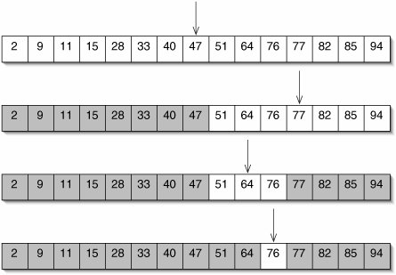
Binary Search
Searching for 76
Test middle element
The search key is greater than the middle element so test the middle element of the second half of the array
The search key is less than the middle element of the remaining portion so test the middle element of the first half of the remaining part.
Check remaining item

Slide 11
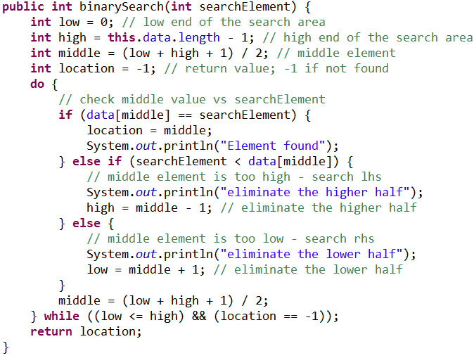
Binary search coded

Slide 12
Efficiency of the Binary Search
In the worst-case scenario, searching a sorted array of 1023 elements takes only 10 comparisons
when using a binary search. Repeatedly dividing 1023 by 2 (because after each comparison we can eliminate half the array) and rounding down (because we also remove the middle element) yields the values 511, 255, 127, 63, 31, 15, 7, 3, 1 and 0. Dividing by 2 is equivalent to one comparison in the binary search algorithm.
An array of over one billion elements takes a maximum of 30 comparisons to find the key. This is a tremendous improvement in performance over the linear search.

Slide 13
Big 0
The major difference between algorithms is the amount of effort they require to complete the search.
One way to describe this effort is with Big O notation, which indicates the worst-case run time for an algorithm—that is, how hard an algorithm may have to work to solve a problem.
Big O notation describes an algorithm’s efficiency in terms of the work required to solve a problem. For searching and sorting algorithms typically it depends on the number of elements in the data.
It is not a test of speed – it tests how an algorithm scales.

Slide 14
Consider this algorithm…
Consider
45n³ + 20n² + 19 = 84
If n=2
45n³ + 20n² + 19 = 459
If n =10
45n³ + 20n² + 19 = 47,019
(45,000) +(2000) + 19 = 47,019
N3 is the important part. Therefore algorithm is said to be an order of n3 O(n3)
Most significant part as the scale increase

Slide 15
O(1) Algorithms
An algorithm adds a new item to an array.
It doesn’t matter how many items are in the array it still performs the same way.
It is constant. (constant run time)
Regardless if 10 items or 10000 items array the algorithm performs in the same way.
On the Order of 1

Slide 16
O(n) Algorithms
An algorithm that tests whether the first array element is equal to any of the other array elements will require at most n – 1 comparisons, where n is the number of array elements.
If the array has 10 elements, this algorithm requires up to nine comparisons. If the array has 1000 elements, it requires up to 999 comparisons. As n grows larger, the n part of the expression “dominates,” and subtracting one becomes inconsequential.
Linear run time
“Order n” or “on the order of n”

Slide 17
O(n²) Algorithms
The effort/time to complete is proportion to the square of the amount of data.
Bubble sort and other algorithms that have nested iterations.
Each pass through an outer loop requires another search through the entire list again.
“On the order of n squared” or “order n-squared”
Quadratic run time
Very poor – to be avoided

Slide 18
O(log n) Algorithms
Example : Binary search
Data used is decreased approximately by 50% each pass in through the algorithm.
Better than O(n) because in O(log n) as n increases (the amount in the array) – it has little effect.
Logarithmic runtime

Slide 19
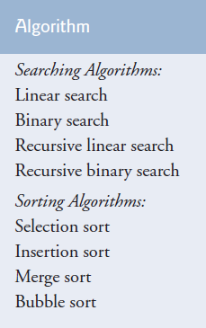
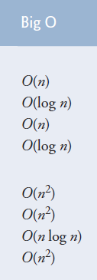
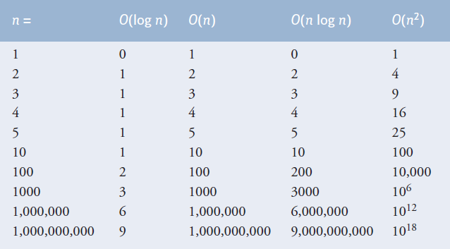
Searching and sorting algorithms with Big O values

Slide 20
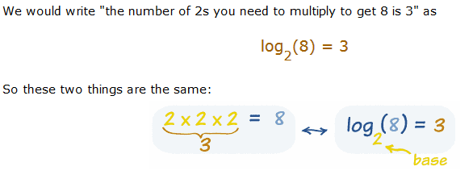
Logs…
log₁₀(1000) = 3
i.e. 10 * 10 * 10 = 1000
The maximum number of comparisons needed for the binary search of any sorted array is the exponent of the first power of 2 greater than the number of elements in the array, which is represented as log2 n. All logarithms grow at roughly the same rate, so in big O notation the base can be omitted. This results in a big O of O(log n) for a binary search, which is also known as logarithmic run time.

